Slide 1

Beach Areas In Florida
Which one is for you?

Slide 2
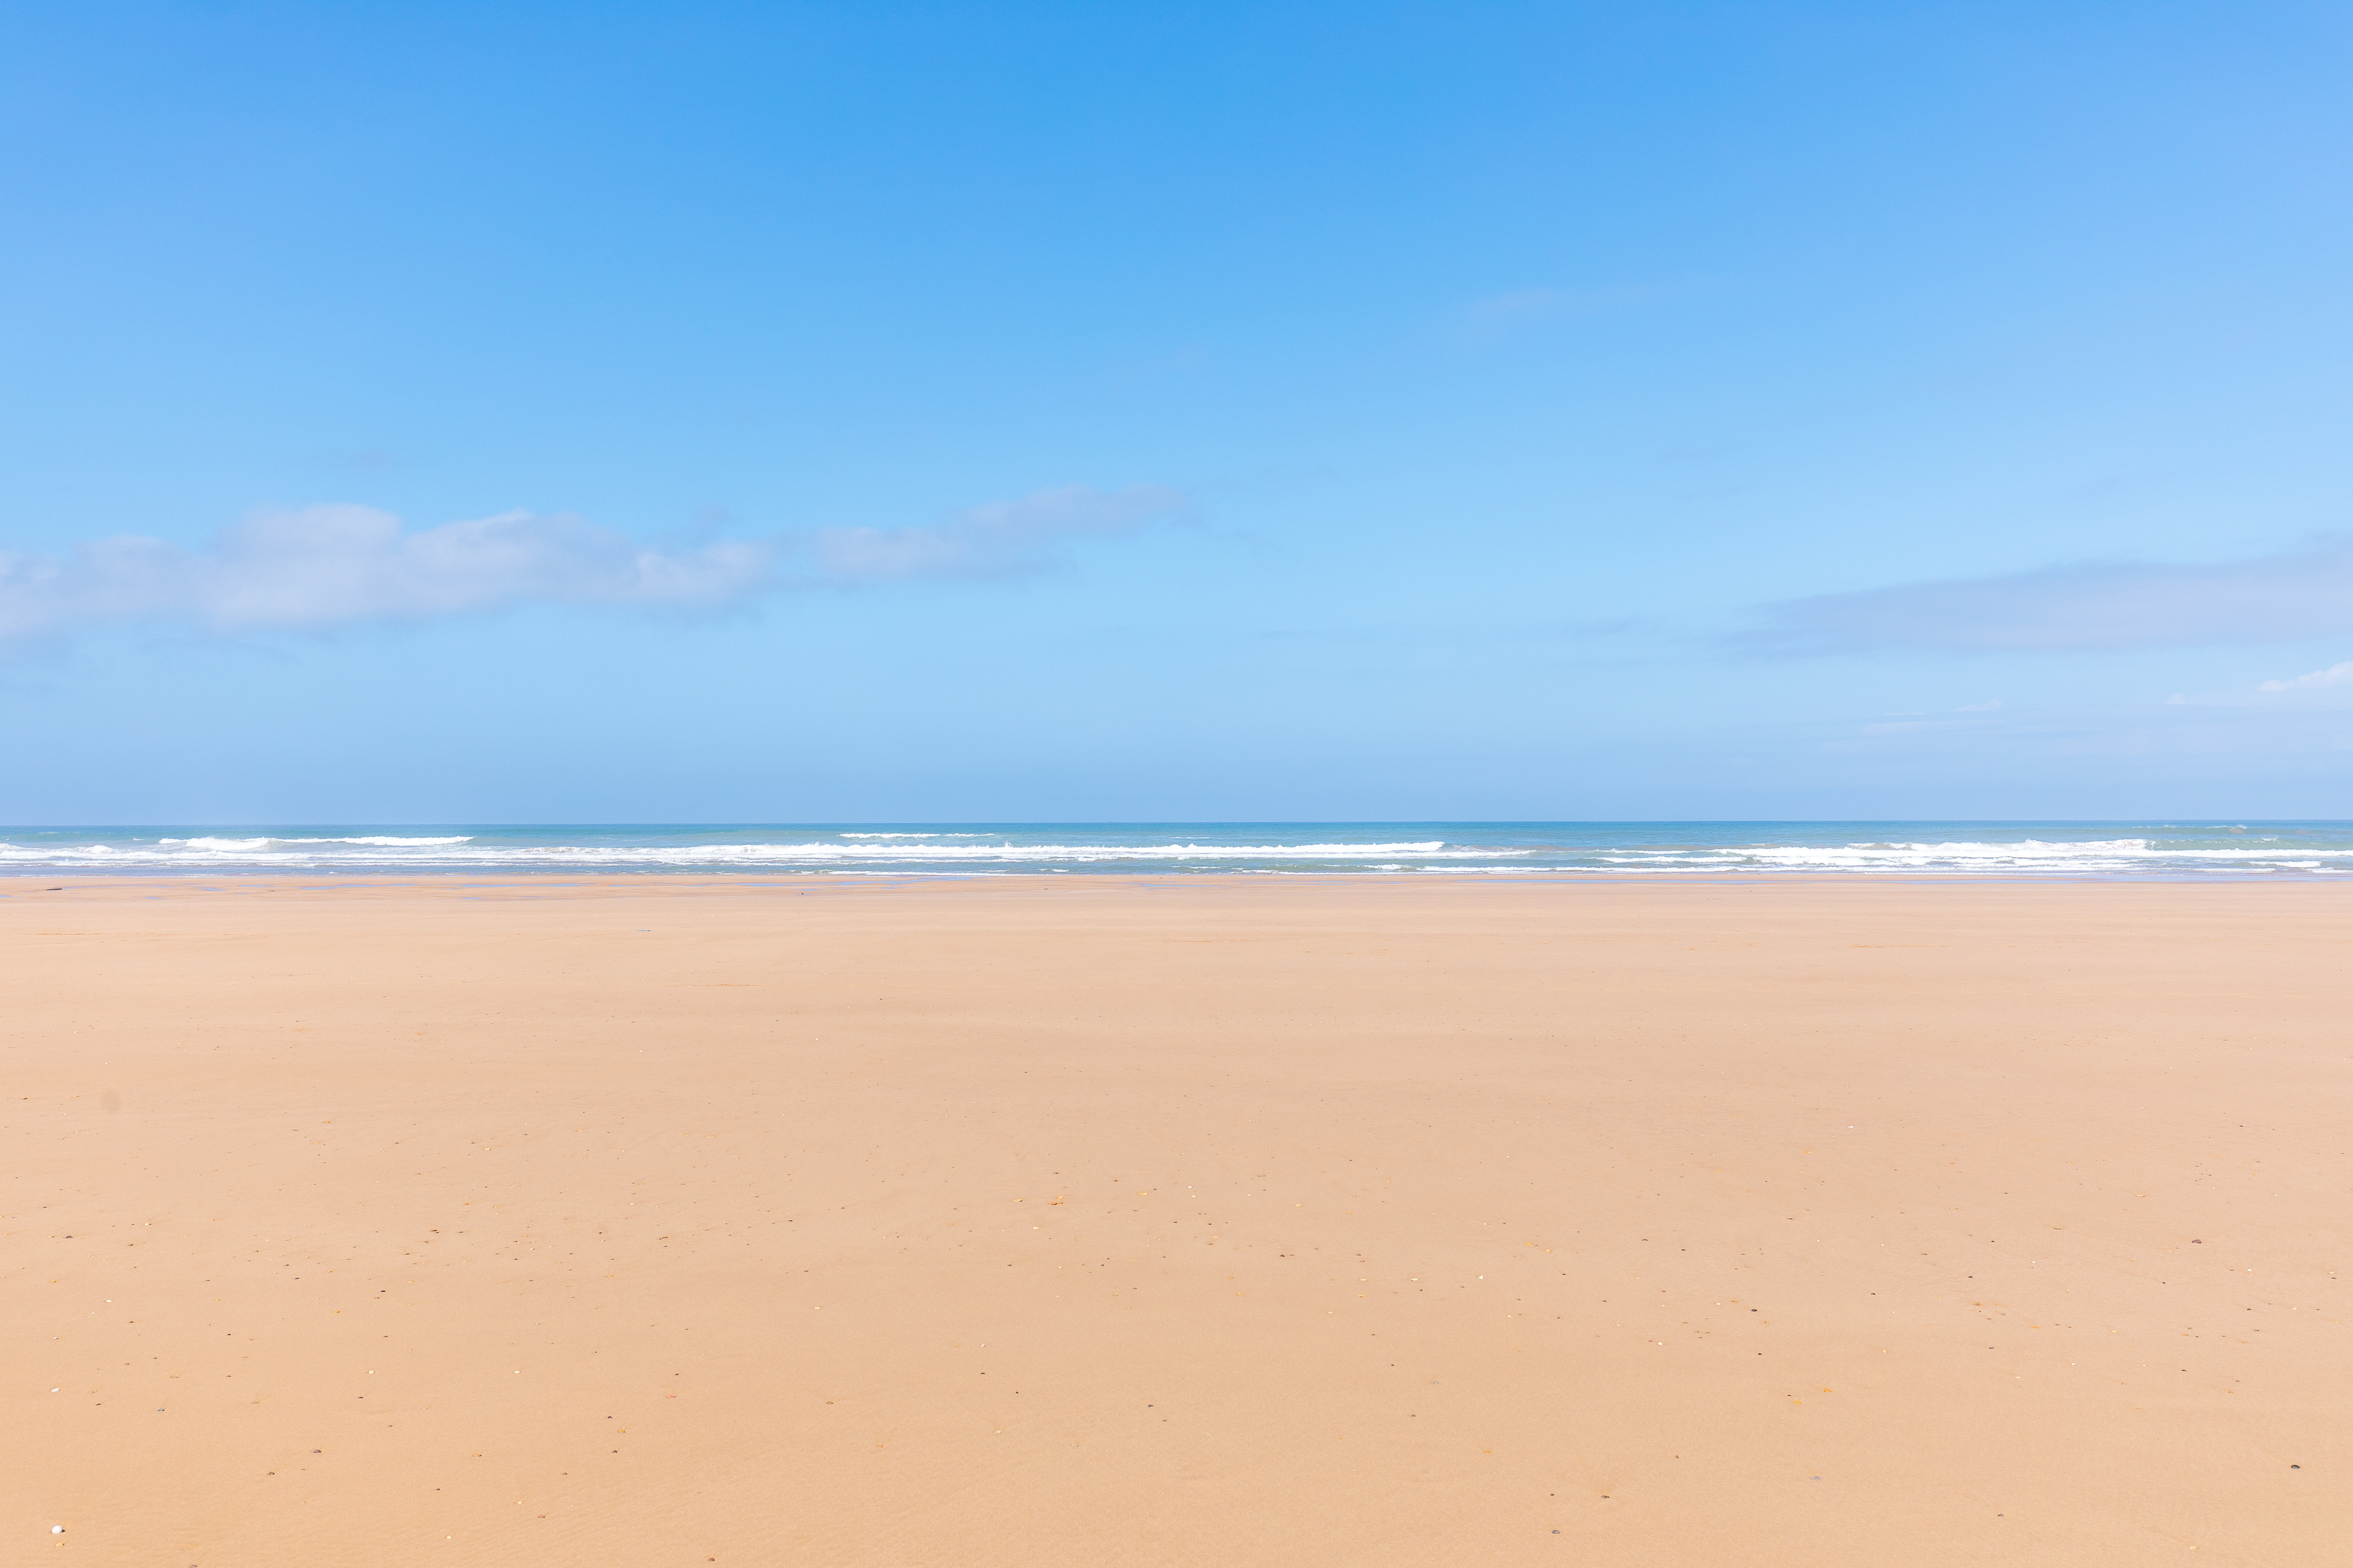
Which areas in Florida does this report cover?
Four different beach locations were reviews across the entire state, each is along the coast and each has a nearby airport for ease of travel
The Panhandle – the northwest corner of the state
Jacksonville – the northeast corner of the state
Tampa/ Clearwater – center/ west coast of Florida
West Palm Beach – southeast section of Florida

Slide 3
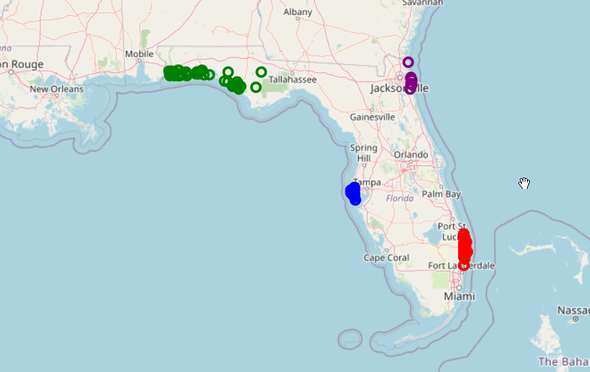
Where are these areas on a map?
The panhandle is identified by the cities in green
Jacksonville is identified by the cities in purple
Tampa/ Clearwater is identified by the cities in blue
West Palm Beach is identified by the cities in red

Slide 4
What types of venues are most common in The Panhandle?
The most common venues in the panhandle of Florida are:
Restaurants
35 Fast food and sandwich restaurants
17 Seafood restaurants
18 Italian and/ or pizza restaurants
11 American restaurants
Outdoor Activities
18 Beaches/ parks
1 Golf Course
28 Hotels and Resorts
18 Discount Stores

Slide 5
What types of venues are most common in Jacksonville, FL?
The most common venues in Jacksonville are:
Restaurants
1 Fast food and sandwich restaurants
5 Italian and/ or pizza restaurants
5 American restaurants
Outdoor Activities
2 Beaches/ parks
16 Golf Courses
3 Hotels and Resorts
3 Discount Stores

Slide 6
What types of venues are most common in Tampa/ Clearwater, FL?
The most common venues in Tampa/ Clearwater are:
Restaurants
10 Fast food and sandwich restaurants
13 Seafood restaurants
14 Italian and/ or pizza restaurants
9 American restaurants
Outdoor Activities
35 Beaches/ parks
4 Golf Course
34 Hotels and Resorts
2 Discount Stores

Slide 7
What types of venues are most common in West Palm Beach, FL?
The most common venues in West Palm Beach are:
Restaurants
36 Fast food and sandwich restaurants
18 Seafood restaurants
23 Italian and/ or pizza restaurants
16 American restaurants
Outdoor Activities
39 Beaches/ parks
6 Golf Courses
19 Hotels and Resorts
11 Discount Stores

Slide 8
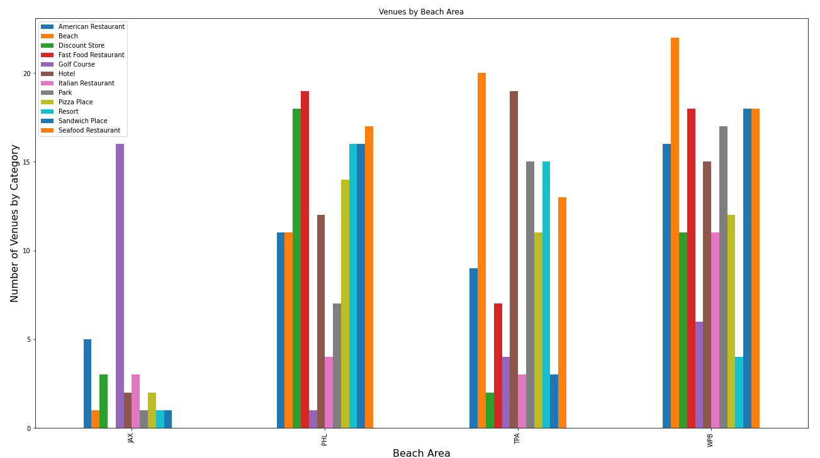
Graph
The graph to the right shows the color codes the number venue types in each of the beach areas analyzed in this presentation.

Slide 9
Thank you and ENJOY YOUR VACATION!

